Slide 1


Directors & the Audience
JiWon Lee

Slide 2
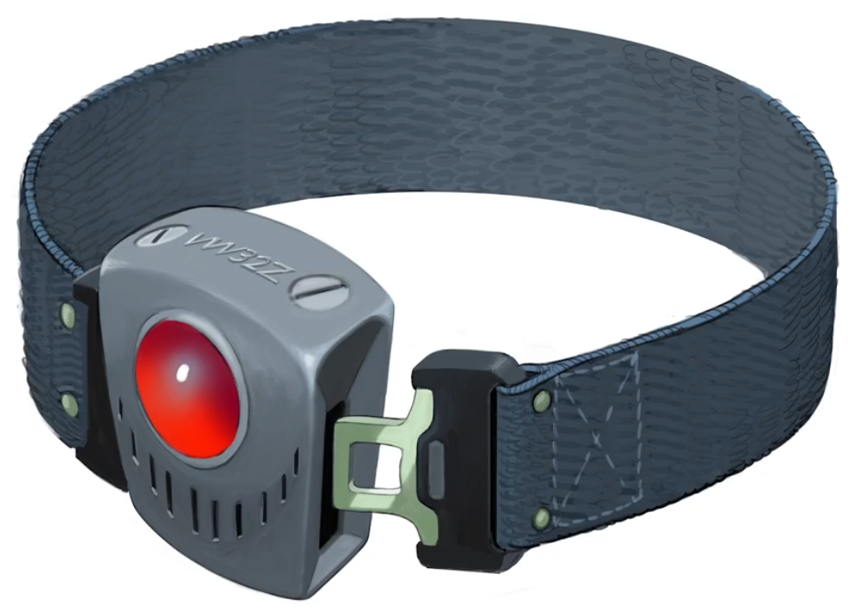

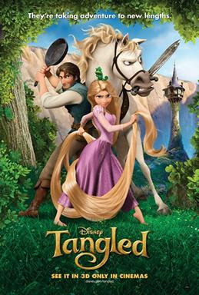
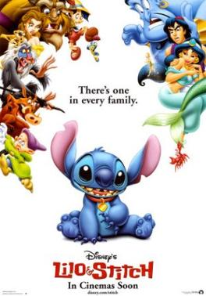

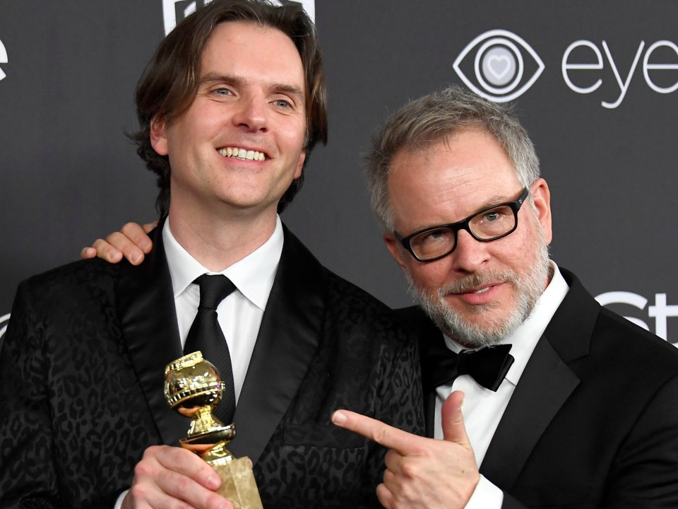
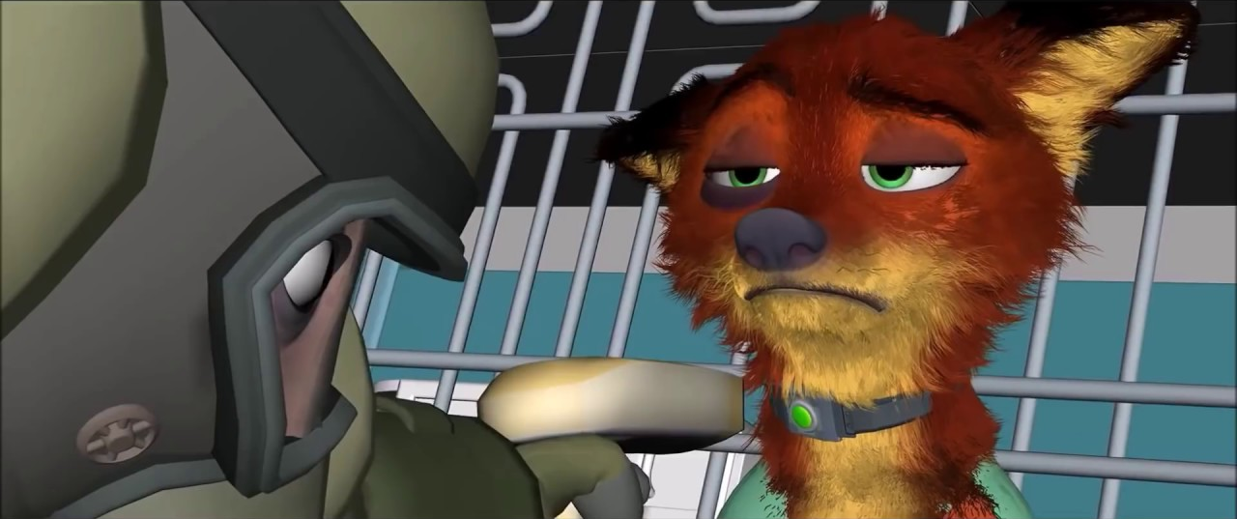
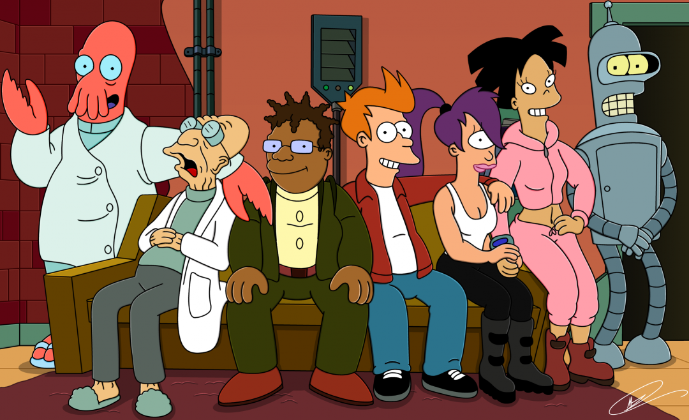
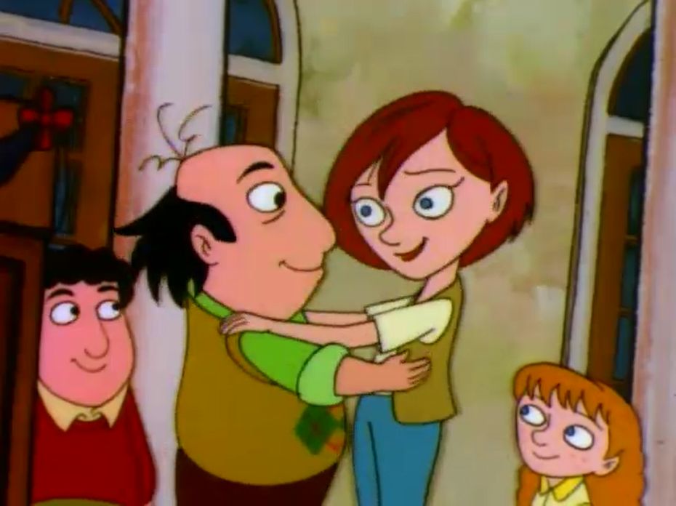

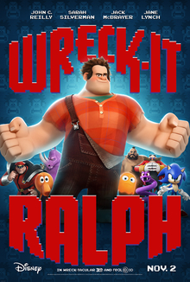
Directors’ Intentions
Byron Howard and Rich Moore
an anecdote: trip to Kenya (Guerrasio, 2017)
injustice, discrimination, and racism (Riley, 2017)
major changes in production process (Sciretta, 2016)

Slide 3
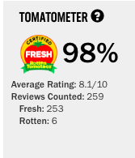
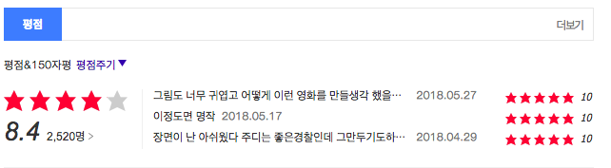
Critical Response
overall positive: 98% on the Rotten Tomatoes (Rottentomatoes.com, 2018) & 8.4 out of 10 on Daum Movies Review (Daum 영화, 2018)
film critics: thought-provoking, subversive, and compelling with its timely message (Genzlinger, 2016) (Travers, 2016)

Slide 4
References
Daum 영화. (2018). Daum영화 <주토피아>. [online] Available at: http://movie.daum.net/moviedb/grade?movieId=89720 [Accessed 4 Jun. 2018].
Genzlinger, N. (2016). Review: In ‘Zootopia,’ an Intrepid Bunny Chases Her Dreams. [online] Nytimes.com. Available at: https://www.nytimes.com/2016/03/04/movies/zootopia-review.html [Accessed 5 Jun. 2018].
Guerrasio, J. (2017). 'Zootopia' directors: Why the movie has a special meaning after the Trump victory. [online] Business Insider. Available at: http://www.businessinsider.com/zootopia-meaning-trump-presidency-2017-1 [Accessed 3 Jun. 2018].
Leadbeater, A. and Donaldson, K. (2016). Zootopia Directors Explain Characters & Challenges of Maintaining Scale. [online] Screenrant.com. Available at: https://screenrant.com/zootopia-directors-interview-characters/ [Accessed 4 Jun. 2018].
Riley, J. (2017). ‘Zootopia’ Helmers Byron Howard, Rich Moore on Their Timely, Subversive Toon. [online] Variety. Available at: https://variety.com/2017/film/in-contention/oscar-nominated-directors-zootopia-1201989619/ [Accessed 4 Jun. 2018].
Rottentomatoes.com. (2018). Zootopia. [online] Available at: https://www.rottentomatoes.com/m/zootopia/ [Accessed 4 Jun. 2018].
Sciretta, P. (2016). Zootopia Directors Interview: The Evolution Of The Story. [online] /Film. Available at: http://www.slashfilm.com/zootopia-directors-interview/2/ [Accessed 5 Jun. 2018].
Travers, P. (2016). 'Zootopia' Movie Review. [online] Rolling Stone. Available at: https://www.rollingstone.com/movies/reviews/zootopia-20160303 [Accessed 4 Jun. 2018].

